Slide 1

Invictus Crypto Strategies Data Analysis Course
Overview: Comprehensive analysis of cryptocurrency trends with a focus on bitcoin
Objective: Utilize machine learning and statistical tools to derive actionable insights.
Authors:
Maxim Savchenko
Ben Hababo
Lev Kravtsov
Shay Tekel

Slide 2
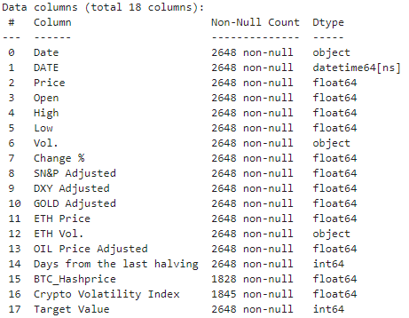
Bitcoin Dataset Overview
Data Source: Bitcoin historical data, detailing price trends, volumes, and other financial indicators.
Columns: Key columns include: ‘Price’, ‘Vol’, ‘Low’, ‘Change%’, and adjusted values for indices.
Size and Format: Dataset contains multiple numeric and categorical features spanning several years.

Slide 3
Data Cleaning and Preparation
Handling Missing Values: Identified and filtered columns with missing data using Pandas.
Conversion: Numeric transformation of columns using custom functions.
Dataset Refinement: Created an updated DataFrame with structured data ready for analysis.

Slide 4
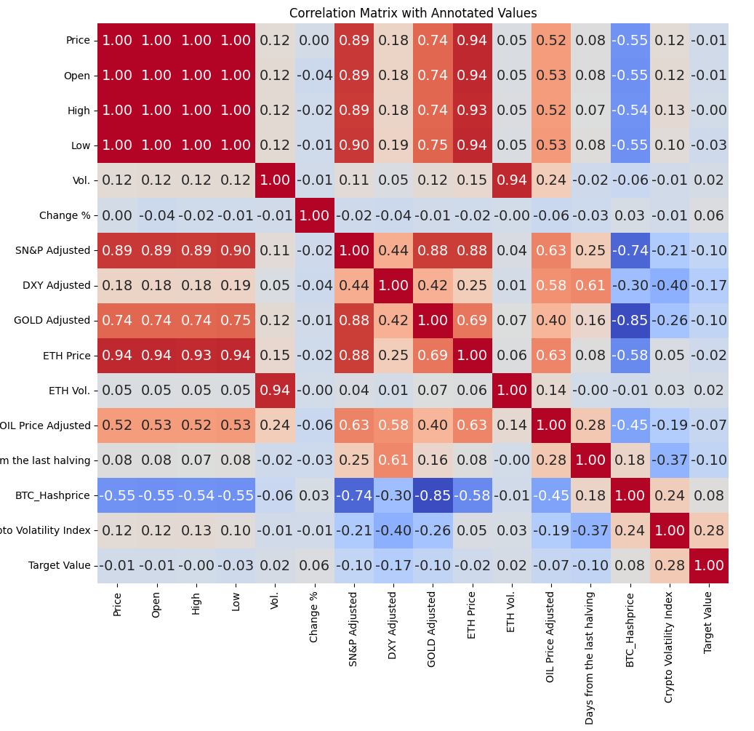
Correlation Matrix
Visualization: Heatmap generated to identify relationships among numeric features.
Key Finding: Strong correlation observed between Bitcoin price and specific indicators like ‘ETH Price’.
Insights: Correlation matrix highlights potential predicators for advanced modeling

Slide 5
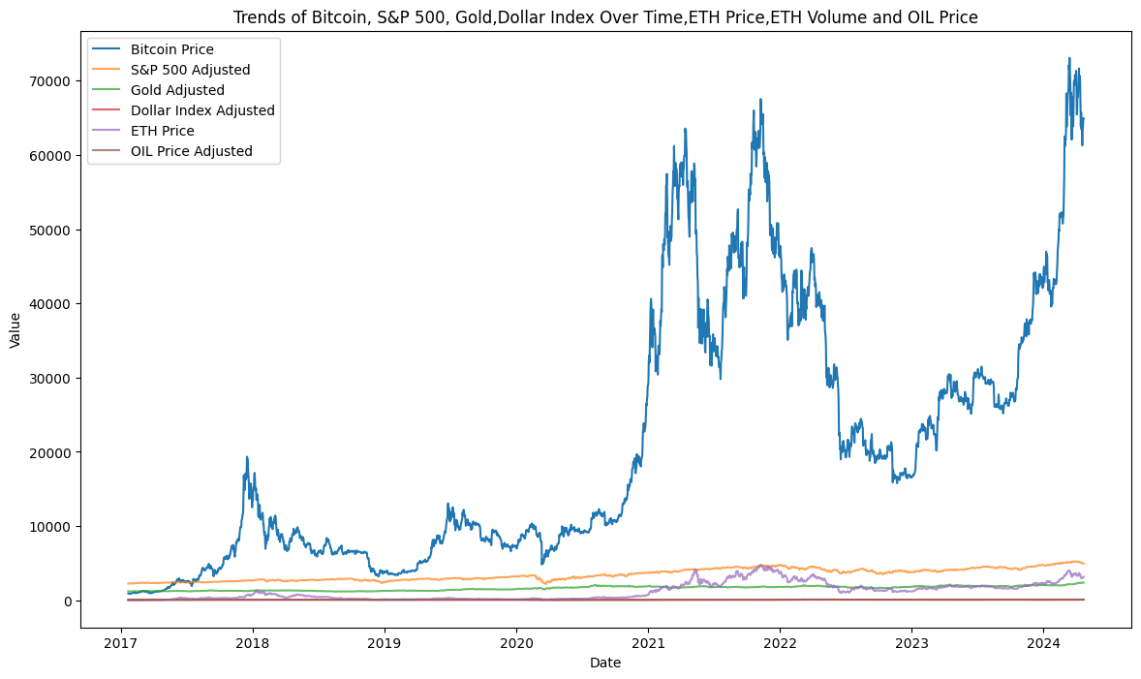
Historical Trends in Bitcoin Price
Bitcoin Price: Historical data shows significant fluctuations over time, reflecting market volatility.
Comparison: Bitcoin trends juxtaposed against S&P 500, Gold, and other indices.
Insights: Trends indicate a complex relationship between Bitcoin and traditional financial assets.

Slide 6
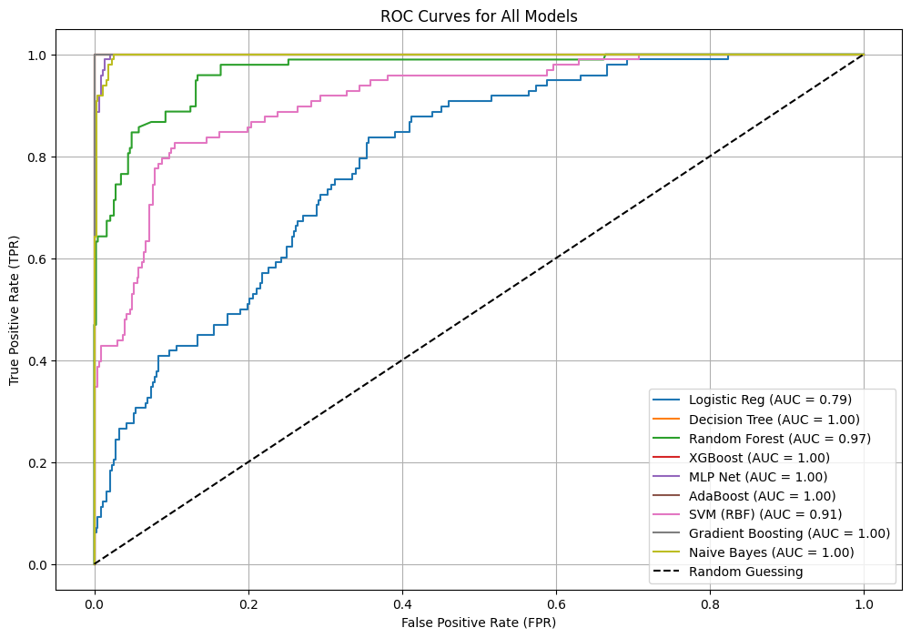
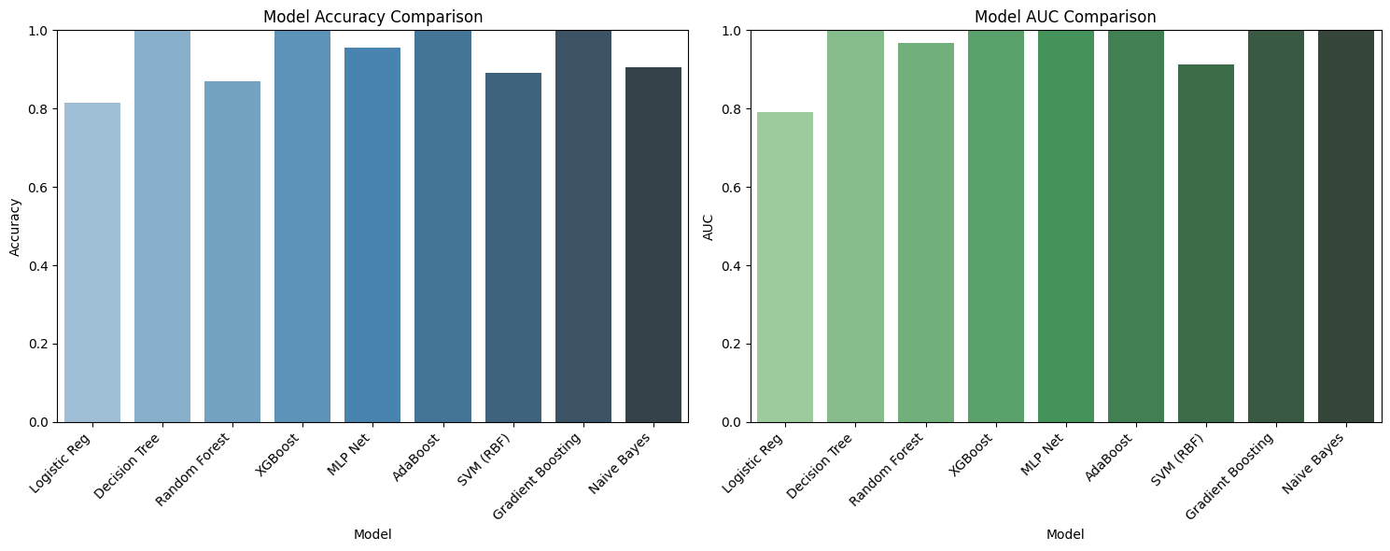
Predictive Modeling
Models Tested: Logistic Regression, Decision Tree, Random Forest, XGBoost, and more.
Evaluation Metrics: Assessed with accuracy, AUC, and precision-recall curves.
Performance Insight: Random Forest and XGBoost emerged as top-performing models.

Slide 7
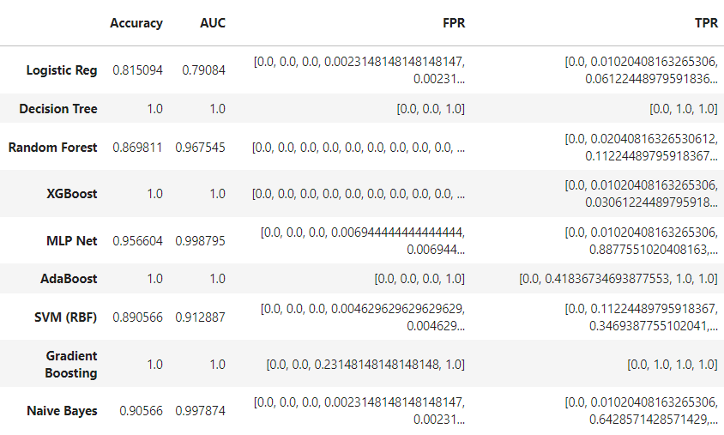
Model Performance Comparison

Slide 8
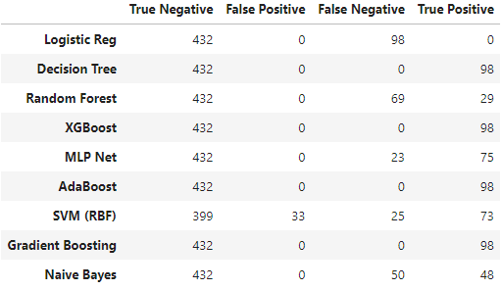
Model Evaluation Metrics
Confusion Matrix: Visualization model predictions to distinguish true positives, false positive, and other outcomes.
Insights: High AUC and precision-recall balance emphasize reliability of ensemble methods.

Slide 9
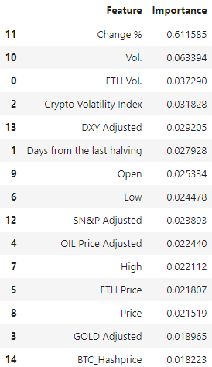
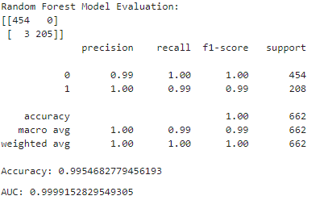
Features Importance Analysis Random Forest Insights
Top Features: ‘Change %’ and ‘Vol.’ ranged highest in influencing predictions.
Methodology: Importance derived using ensemble-based metrics in Random Forest.
Insights: Emphasizes significant predictors for strategic Bitcoin trading.

Slide 10
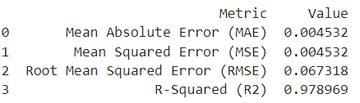

MCC and Error Metrics
Matthews Correlation Coefficient (MCC): Achieved MCC of 0.989, indicating excellent performance on imbalanced data.
Error Metrics Evaluation:
Mean Absolute Error (MAE): Evaluates average absolute error, indicating model prediction precision.
Root Mean Squared Error (RMSE): Captures larger errors more effectively; ideal for financial data.
R-squared (R2): Explains variance in Bitcoin prices; key metric for reliability.

Slide 11
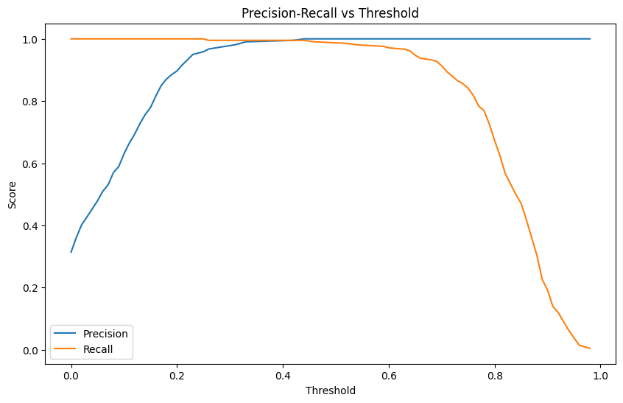
Precision-Recall vs. Threshold
The Precision-Recall vs. Threshold chart provides a deeper understanding of how the Random Forest model performs at varying classification thresholds.

Slide 12
Conclusion
Key Insights and Recommendations:
Performance Highlights: XGBoost and Random Forest outperformed with high accuracy and reliability.
Strategic Insights: Feature analysis identified ‘Change %’ and ‘Vol.’ as key predictors.
Future Scope: Incorporate additional macroeconomic variables for enhanced prediction accuracy.

Slide 13
Thank you!

